Slide 1
Applicative Project-1
Title:
Intelligent Machines in Vehicle Platooning
By
Students:
1. Keerthana Bollepally
2.Alaka Asritha Ghantasla
3.Riya Reddy
4.Sri Sai Siri
Supervisor Name:
Dr.ReddyShekar
SOT-School of Technology Woxsen University

Slide 2
Applicative Project-1
Title:
Contents:
Abstract
Introduction
Literature survey
Existing System
Proposed System
Novelty
Software Requirements
Hardware Requirements

Slide 3
Applicative Project-1
Abstract
This project focuses on developing an advanced vehicle platooning system that is adaptable to various vehicle types, including trucks, buses, and cars.
Propose an integrated communication framework for vehicle platooning.
Utilize existing communication standards, including Dedicated Short-Range Communications (DSRC) and Cellular Vehicle-to-Everything (C-V2X).
Integrate Group Communication Protocol (GRP) and Geographical Routing Protocol (GPSR) to improve communication efficiency.
The solution contributes to the development of intelligent transportation systems through reliable and adaptive communication methods.

Slide 4
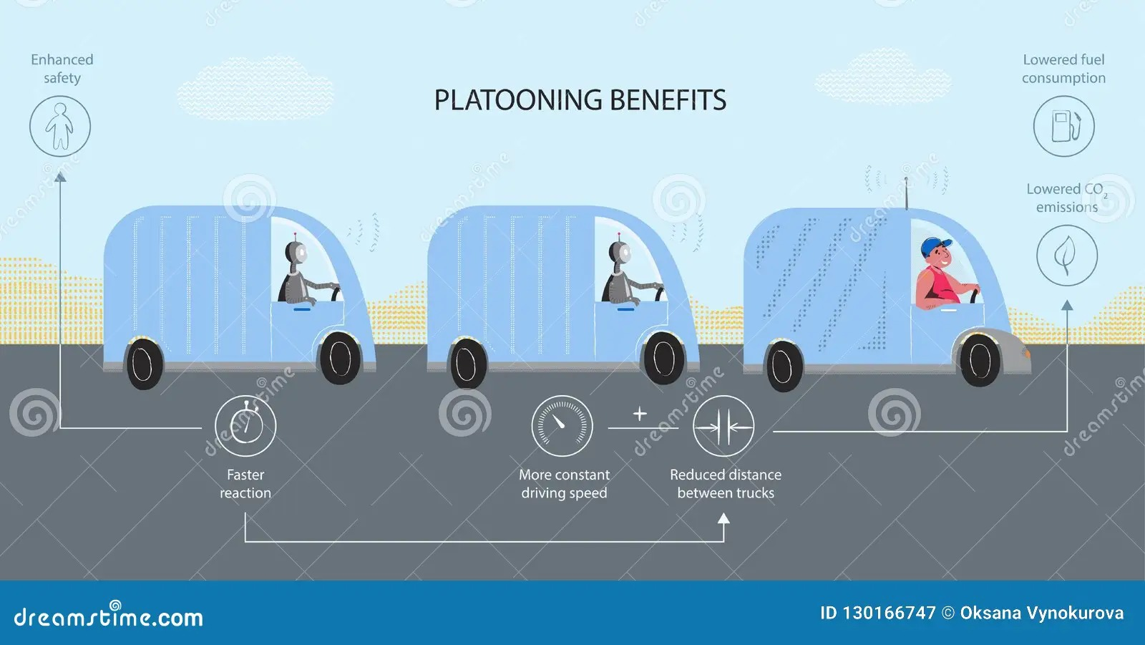
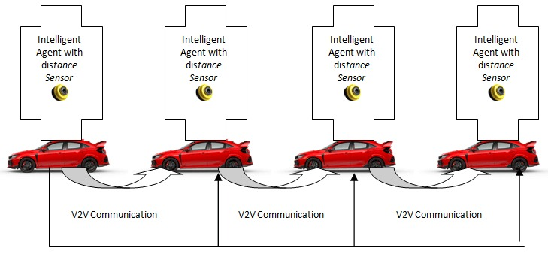
Applicative Project-1
Introduction
Vehicle platooning refers to a group of vehicles that travel closely together, coordinated through automated driving technologies and Vehicle-to-Vehicle (V2V) communication.
The primary goal is to improve road safety, reduce fuel consumption, and enhance traffic flow.

Slide 5
Applicative Project-1
Literature Survey
Vehicle Platooning: A Detailed Literature Review on Environmental Impacts and Future Research
(https://www.mdpi.com/2673-7590/4/2/28)
. A Comprehensive Review of Geographic Routing Protocols in Wireless Sensor Network
(https://library.acadlore.com/IDA/2022/1/1/IDA_01.01_03.pdf)
Prediction-based Greedy Perimeter Stateless Routing Protocol for Vehicular Self-organizing Network
(https://iopscience.iop.org/article/10.1088/1757-899X/322/5/052019)
Survey on Challenges and Solutions of C-V2X Communication Technology
(https://ieeexplore.ieee.org/document/10201105)
Analysis of greedy perimeter stateless routing protocol network simulation using bird flocking algorithm
(https://www.researchgate.net/publication/359624349_Analysis_of_Greedy_Perimeter_Stateless_Routing_Protocol_Network_Simulation_using_Bird_Flocking_Algorithm)

Slide 6
Applicative Project-1
Existing Systems
DSRC (Dedicated Short-Range Communication):
DSRC is a wireless communication technology designed specifically for vehicular communication.
DSRC is a Wi-Fi-like communication technology designed specifically for vehicle-to-vehicle (V2V) and vehicle-to-infrastructure (V2I) communication.
It has a range of about 300 meters and can handle high-speed data transfer, making it suitable for real-time communication in fast-moving vehicles.
Challenges: Limited range, potential interference, and slower adoption compared to newer technologies like C-V2X.

Slide 7
Applicative Project-1
Existing Systems
C-V2X (Cellular Vehicle-to-Everything):
C-V2X is a cellular-based technology that allows vehicles to communicate with each other (V2V), with infrastructure (V2I) and with the broader network (V2N).
Enables V2V(Vehicle to Vehicle) and V2I(Vehicle to Infrastructure) communication without involving the cellular network.
C-V2X offers greater range and the ability to support higher bandwidth through cellular networks. It also prepares for 5G, which will further enhance speed and responsiveness.
Challenges: Depends on cellular network availability, and currently, the ecosystem is still developing compared to DSRC’s more established standards.

Slide 8
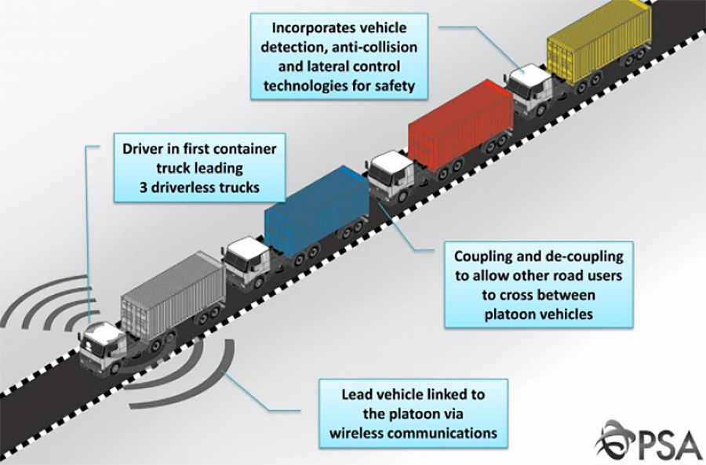
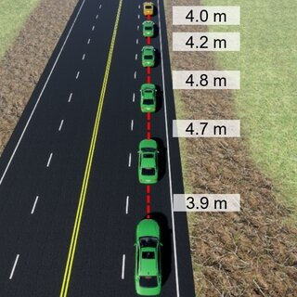
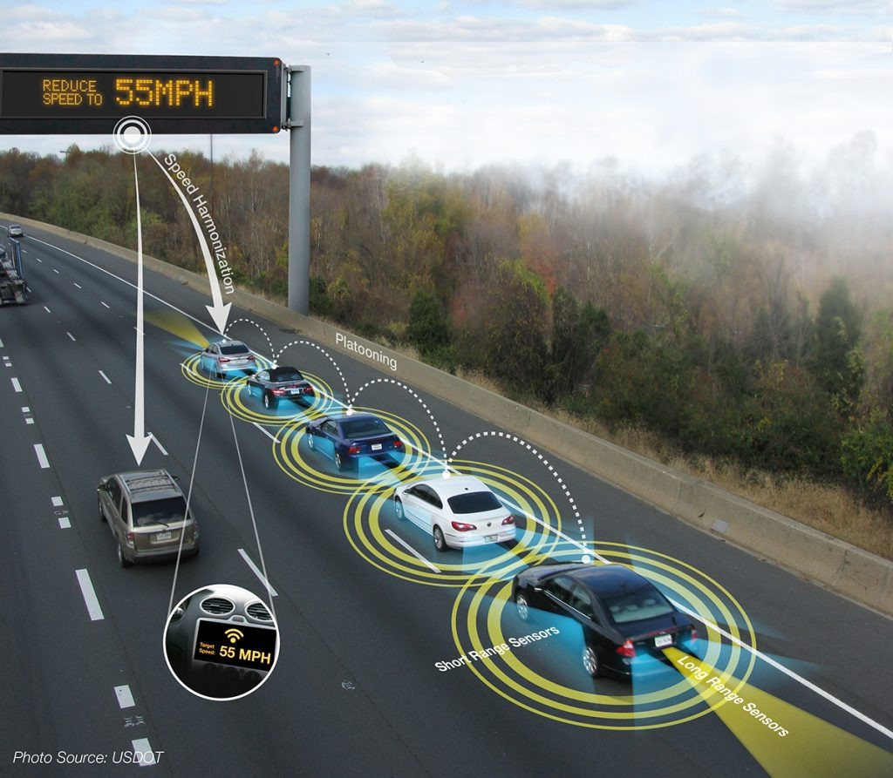
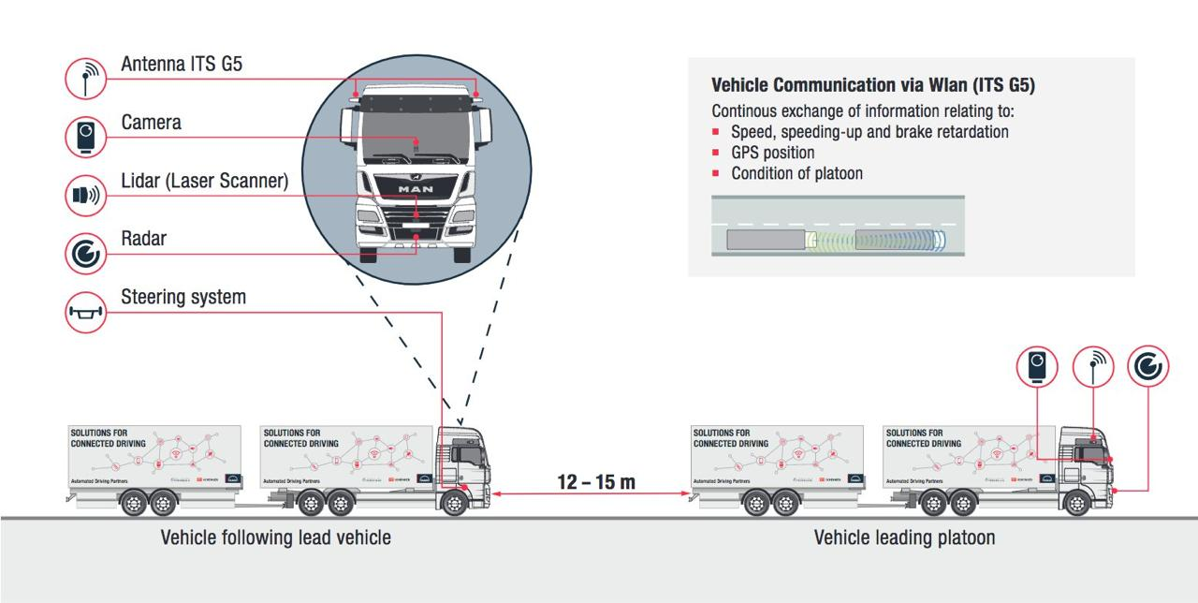

Slide 9
Applicative Project-1
Proposed System
Goals of the Project:
Objective 1: To integrate DSRC and C-V2X with GRP and GPSR to create a robust communication framework that optimizes data exchange within vehicle platoons, ensuring timely and reliable communication.
Objective 2:Implement GRP to enable dynamic formation and reconfiguration of vehicle groups based on real-time conditions, improving adaptability and responsiveness in changing traffic environments.
Objective 3:Utilize GPSR to enhance routing decisions based on geographic positioning, minimizing delays and ensuring efficient data delivery between vehicles in the platoon.

Slide 10
Applicative Project-1
Novelty
The combination of DSRC, C-V2X, GRP, and GPSR creates a unique multi-layered communication system that leverages the strengths of existing technologies while introducing innovative routing and group communication methods.
The integration of GPSR provides a novel way to optimize data routing based on geographic information, leading to more efficient data transmission and reduced latency in communication among platoon vehicles.
Unlike traditional systems that use static communication protocols, this approach allows for dynamic vehicle group formation, adapting to real-time traffic conditions and enhancing operational efficiency.
The innovative combination of these protocols contributes to the broader field of intelligent transportation systems (ITS), potentially setting a new standard for communication in vehicular networks.

Slide 11
Applicative Project-1
Software Requirements
SUMO (Simulation of Urban MObility):
Traffic simulation to model vehicle movement and platooning behavior, used to visualize and simulate vehicle platooning scenarios and traffic management.
2. OMNeT++:
Network simulation platform for communication system modeling. Simulate communication between vehicles using different technologies like LiFi, C-V2X, and DSRC.
3. Veins Framework:
Integrate vehicular communication (DSRC, C-V2X) with OMNeT++ and SUMO for realistic V2X communication scenarios. Veins for modeling DSRC communication; optionally, Veins LTE for LTE-based vehicle communication.
4. NS-3 (if used): Network simulation alternative to OMNeT++.

Slide 12

Applicative Project-1
Software Requirements
5. Python (if required):
Custom development and integration of hybrid communication systems.
Develop AI-driven algorithms for communication switching and real-time monitoring of network conditions.
AI Libraries
Matplotlib/Seaborn
Pandas/Numpy

Slide 13
Applicative Project-1
Hardware Requirements
Processor (CPU)
2. RAM
3. Graphics Processing Unit (GPU)
4. Storage
5. Operating System(suitable for OMNeT++, Veins, SUMO)

Slide 14
Applicative Project-1
Thanking You

